Slide 1
Lab 02 Recitation Random Wander, Avoid-Obstacle, Follow-Object
Create a random wander behavior on the mobile robot
Create an obstacle avoidance behavior on the mobile robot
Create an object follow behavior on the mobile robot
Use potential fields to create the collide, avoid, and follow behaviors (shy kid, aggressive kid, curious kid)
Create a smart follow behavior on the mobile robot
Crate a smar twander behavior on the mobile robot

Slide 2
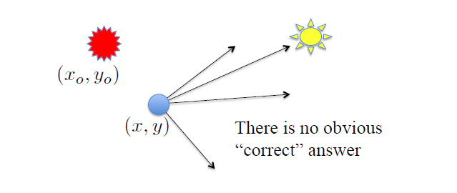
Avoid-Obstacle Behavior
How does a robot avoid driving into obstacles?
Use a desired heading to a goal while moving away from the obstacle.
obstacle
goal (x_{g},y_{g})
robot

Slide 3
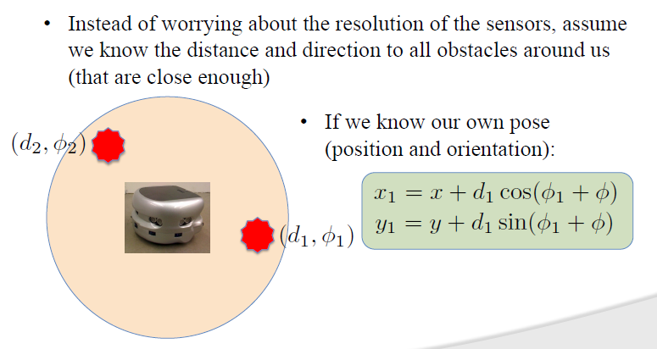
Mobile Robot Disk Abstraction
robot (x, y, φ)

Slide 4
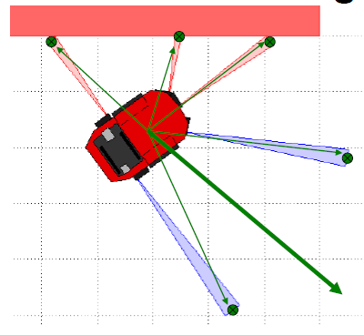
Sum Vectors to Avoid Obstacle
Sum all of the vectors for the distance sensors with respect to the robot reference frame
Steer the robot in the direction of the orientation of the summation vector

Slide 5
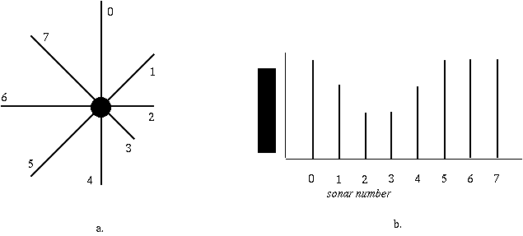
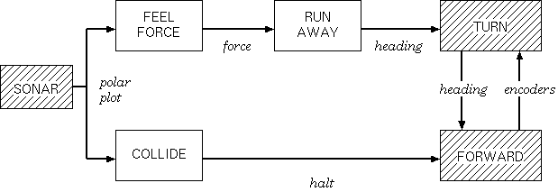
Perception Polar Plot
Notes:
Perception Polar Plot
The perception plot is egocentric to eliminate a need for memory representation
Sonar 2 and 3 indicate that there is a wall and no need for memory or reasoning

Slide 6
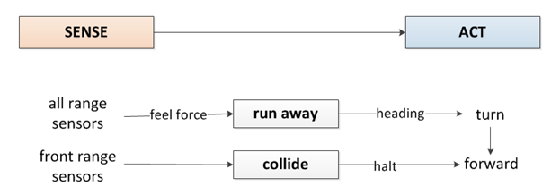
Level 0: Avoid Obstacle
Shy
Kid
Aggressive Kid
Notes:
Most basic type of control architecture, reactive control is the robot senses and then immediately acts.
This can transition to behavior based control when the behavior is time extended such as wall following or obstacle avoidance.

Slide 7
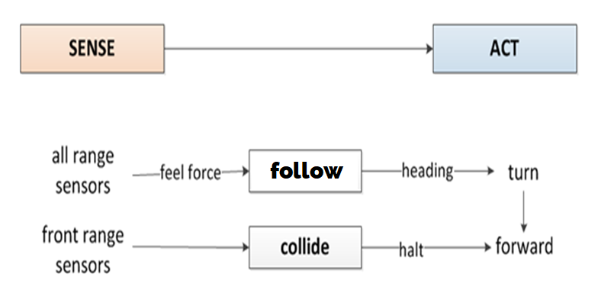
Level 0: Follow Object
Curious Kid
Aggressive Kid
Notes:
Most basic type of control architecture, reactive control is the robot senses and then immediately acts.
This can transition to behavior based control when the behavior is time extended such as wall following or obstacle avoidance.

Slide 8
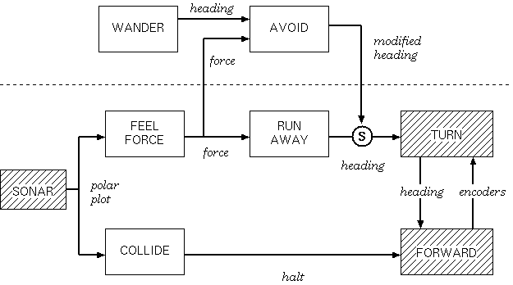
Level 1: Wander
Notes:
Level 1: Wander

Slide 9
Control Schemes
Bang-Bang (On-Off)
Collide Behavior
Proportional
Run Away or Follow Behavior
Controller turns ON when the error is in a given band, stops motor
Controller turns OFF when the error is outside the given band, motors on
Controller is always on but responds proportional to amount of error. The closer the obstacle, the faster the motor moves.
The robot turns proportional to the IR sensors triggered

Slide 10
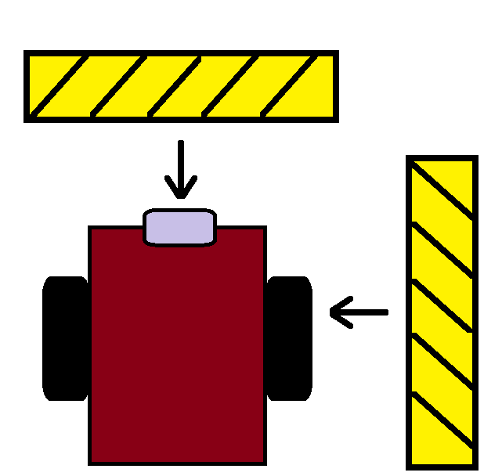
Random Wander
GREEN LED

Slide 11
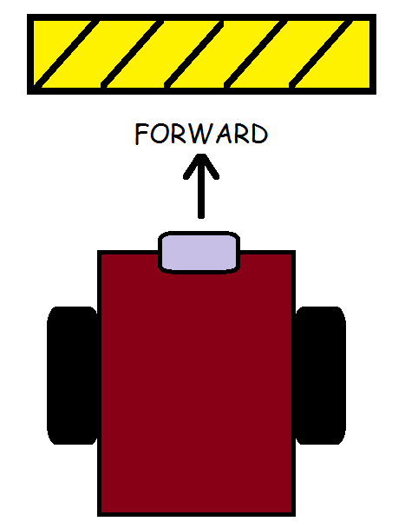
Demonstration
Collide Behavior
Aggressive Kid
RunAway Behavior
Shy Kid
RunAway Behavior
Shy Kid
YELLOW LED
RED LED
YELLOW LED

Slide 12

Halt Collide Behavior

Slide 13
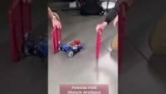
Potential Fields Obstacle Avoidance

Slide 14
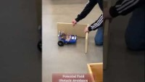
Potential Fields Obstacle Avoidance

Slide 15

Follow Behavior Curious Kid
YELLOW LED
GREEN LED

Slide 16
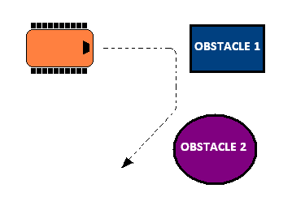
Random Wander & Obstacle Avoidance

Slide 17

Potential Field Navigation and Proportional Control

Slide 18
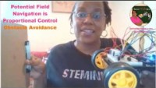
Potential Field Navigation & Proportional Control for Obstacle Avoidance

Slide 19
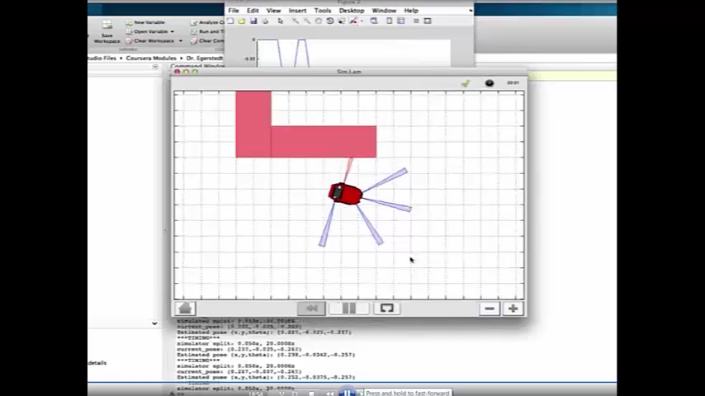
Avoid-Obstacle Simulation

Slide 20
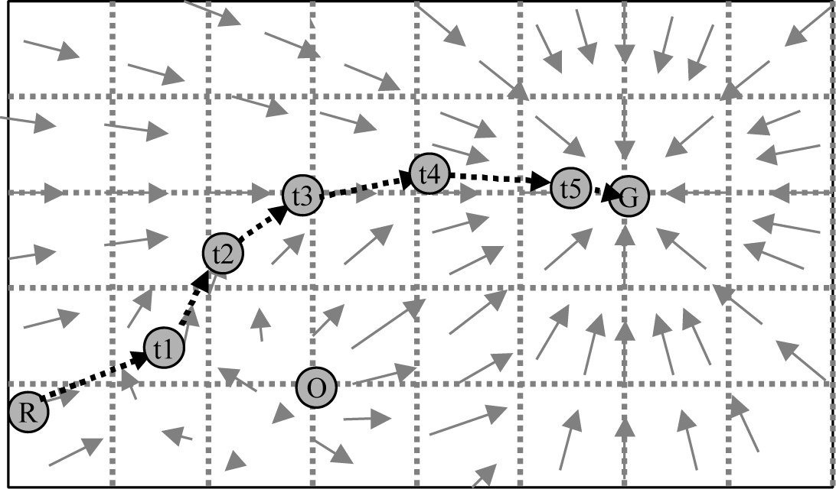
Go-To-Goal & Obstacle Avoidance

Slide 21
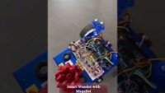
Smart Wander

Slide 22
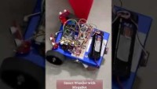
Smart Wander

Slide 23
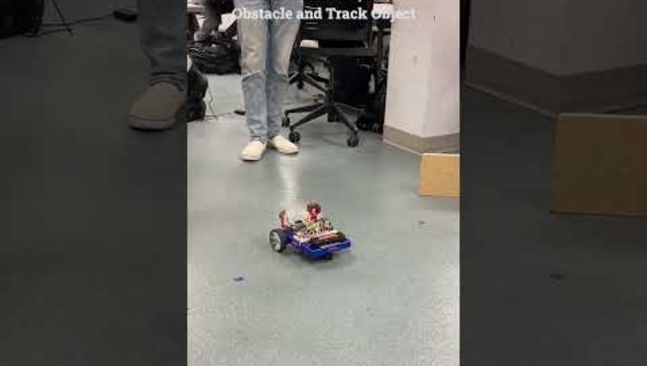
Smart Following

Slide 24
Logic Flow Chart
Great way to sketch out how a circuit or code should work
A flow chart is a game plan
The parts of a flow chart are
Circle
Diamond
Square
Line
Circle is start or stopping point
Square is an action with one outcome
Diamond represents a decision with multiple possible outcomes
Lines connect all of the parts of the flow chart

Slide 25
Flowchart or Algorithmic State Machine
State – Action
A rectangular box to denote a state. State name is attached outside the box. Output variable assignments are included in the box
Condition - Decision
A diamond box to denote a conditional branch.
One entry and two exits for a binary decision.
Output
Moore machine outputs based on state input
Mealy machine generates outputs on state transition
There is always an entry point. There may be zero to many exit points
Start - End
state or
action
condition
output
Start/
End

Slide 26
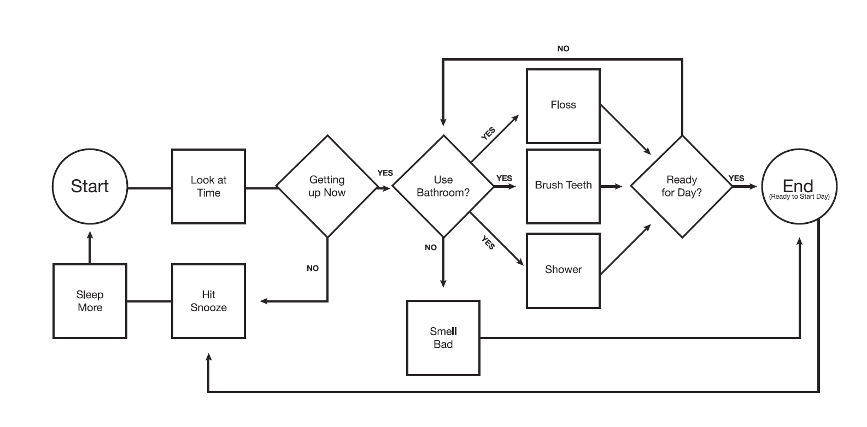
Sample Flow Chart

Slide 27
Stopwatch Flowchart
Start
Clear
State0
Counter=0
Reset=1
Run=0
Button
0
Run
1
1
Counter=Counter+1
Reset=0
Run=1
Button
0
State1
Button
0
1
Counter=Counter
Reset=0
Run=0
Stop

Slide 28
State Diagrams
State diagrams can be used to describe the behavior of a system.
The state of a system represents the net effect of all previous inputs to the system
previous state
input
current state
output
next state

Slide 29
Design Plan: Stopwatch State Diagram
Notes:
If I was writing code, I would make functions reset, run and stop

Slide 30

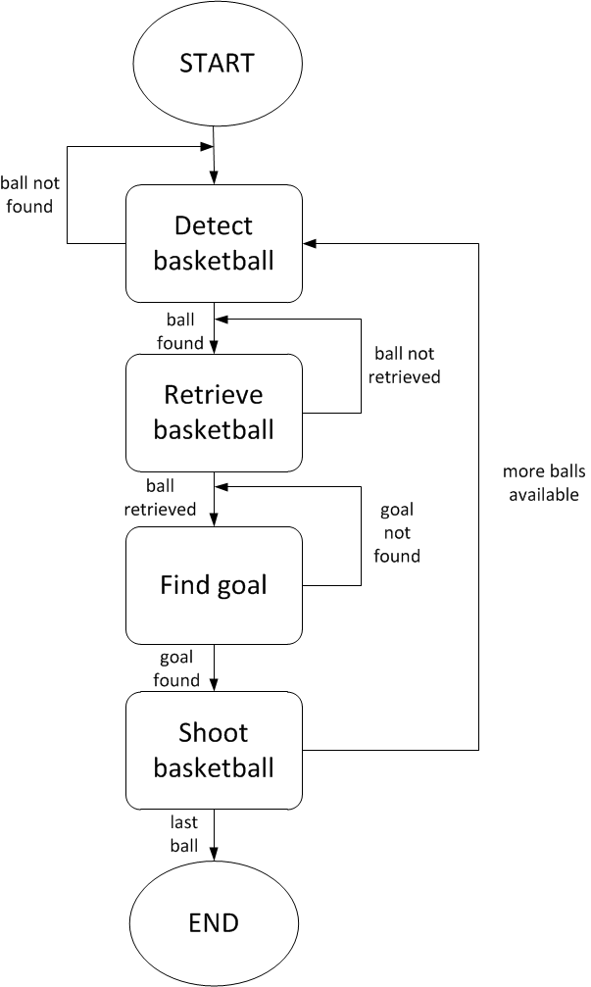
State Diagrams
STATE TRANSITION TABLE
state | input | Output | next state
Detect basketball | Ball not found | Ball found | Retrieve basketball
Detect basketball | More balls available | Ball found | Retrieve basketball
Retrieve basketball | Ball found | Ball not retrieved | Retrieve basketball
Retrieve basketball | Ball found | Ball retrieved | Find goal
Find goal | Ball received | Goal not found | Find goal
Find goal | Ball received | Goal found | Shoot basketball
Shoot basketball | Goal found | More balls available | Detect basketball
Shoot basketball | Goal found | Last ball | End

Slide 31
Flowchart (Program Perspective)

Slide 32
State Diagram (Robot Perspective)
Notes:
Creating a state machine in code
Use if-conditions
Use switch cases
Use flags
Use byte with bit switching

Slide 33
State Transition Table (Robot Perspective)
Robot Boogie Machine
States | Input | Output | Next State
Waiting to Dance | no music hard rock music | country music hip hop music classical music | Line Dance Break Dance Ballet
Break Dance | hip hop music | no music, hard rock music country music classical music | Waiting Line Dance Ballet
Line Dance | country music | no music, hard rock music classical music hip hop music | Waiting Ballet Break Dance
Ballet | classical music | no music, hard rock music hip hop music, country music | Waiting Break Dance Line Dance

Slide 34
Implementing State Machines
#define RESET 0
#define RUN 1
#define STOP 2
int STATE;
…
void loop() {
if(STATE==RESET) {
if(BUTTON_PRESSED) {
NEXT_STATE = RUN
}
…
} else if(STATE==RUN) {
…
}
STATE = NEXT_STATE;
}

Slide 35
Switch/Case
switch(STATE) {
case RESET:
if(BUTTON_PRESSED) {
NEXT_STATE = RUN;
}
break;
case RUN:
…
break;
}
STATE = NEXT_STATE;

Slide 36
Switch/Case
Switch/Case is a different way of implementing an if/else decision
break is important!
Otherwise, code keeps going on
default is used if none of the cases match

Slide 37
Pre-Lab 02
Create the pseudocode for the random wander behavior
Create a flowchart for a proportional controller with sensor feedback for avoid obstacle behavior.
Create a flowchart for a proportional controller with sensor feedback for follow object behavior.
Create a state diagram for the smart wander behavior with 3 states including random wander, collide, and avoid obstacle. The inputs that transition the states are no obstacle, danger at obstacle, warning close to obstacle. Make sure to include a state transition table for the smart wander behavior state diagram.
Create a state diagram for the smart follow behavior with 3 states including random wander, collide, and follow object. The inputs that transition the states are no obstacle, danger at obstacle, warning close to obstacle. Make sure to include a state transition table for the smart follow behavior state diagram.

Slide 38
Lab 02 Demonstration
PART I
Robot random wander
Robot collide
Robot runaway (1,2,3,4 obstacles)
Robot follow (1 obstacle)
PART II
Robot smart wander
Robot smart follow

Slide 39
Demonstration Requirements
Collide (Aggressive Kid) Alone
Run Away (Shy Kid) Alone
Random Wander Alone
Avoid-Obstacle Behavior (Collide & Run Away)
Follow-Object Behavior (Collide & Follow)
Full State Machine (Smart Follow)
Random Wander
Follow-Object Behavior
Full State Machine (Smart Wander)
Random Wander
Avoid-Obstacle Behavior
Notes:
Your code should be able to turn the states on and off via inputs from a wireless communication device and function calls.

Slide 40

Submission Guidelines
Demo part I next class
Demo part II one week
Submit memo and code by midnight on Sunday after demo to GradeScope
Comment your code with a proper heading and in-line comments and submit in appendix of Lab worksheet

